Slide 1
PDF Analysis
By Moshe Kaplan

Slide 2
Overview
What is a PDF file?
How do attackers use them?
How can we analyze them?

Slide 3
What is a PDF file?
Short for “Portable Document Format”
Designed to present documents on a wide variety of systems in a consistent manner
Became very popular after Adobe distributed Reader free of charge.
Now one of the most common file types seen on the Internet

Slide 4
PDF Capabilities
PDF supports many features:
Text, fonts, images, and videos
Fonts can be embedded or from the system
Vector and raster graphics
Forms
Includes electronic submission and JavaScript validation
Encryption
PDFs can be encrypted to control access

Slide 5
Attackers love PDFs!
Adobe Reader has a history of security issues:
OpenAction
JavaScript
Font Bugs
Decoder Bugs
Phishing Links

Slide 6
Attacker Features – OpenAction/AA!
PDF supports specifying an OpenAction, which runs a command when the PDF is first opened.
This functionality is built-into the PDF spec.
Automatic commands can also be specified via AA (Additional Action) entries.
Allows running an arbitrary program on the system or an embedded executable
That sounds bad…
Some PDF Readers didn’t even ask first!
Uh-oh….
History:
“Discovered” by Didier Stevens in March 2010
“Fixed” in Adobe Reader 9.3.3 in June 2010
Very uncommon in legitimate PDFs
Presence indicates that the PDF is likely malicious
Notes:
https://zeltser.com/media/docs/analyzing-malicious-document-files.pdf

Slide 7
Attacker Features - JavaScript!
PDF supports embedding JavaScript.
Not inherently malicious.
Often used to exploit bugs located in other code.
Also used to exploit bugs in the JavaScript engine.
Most benign PDFs don’t include JavaScript
If a PDF has JavaScript, examine it closely!

Slide 8
Attacker Features - Decoder Bugs
PDFS Support many file formats:
JPEG, SWF, and many more!
These decoders can be complicated.
Complicated code means bugs.
Examples:
The JBIG2 decoder had a bug which was exploited in the wild for code execution.
The TIFF image decoder also had a bug that could be exploited for code execution

Slide 9
Attacker Features - Phishing
PDFs are documents with words, pictures and links.
Attackers sometimes put the malicious link in a PDF instead of directly in the email.
This makes it harder for automated tools to extract and check the link.
The PDF could also contain a form which sends the inputs to the attacker.

Slide 10
Attackers love PDFs - Recap!
OpenAction/AA
Run command when PDF is opened. Usually bad.
JavaScript
Enable interactive features. Often malicious, sometimes legitimate.
Decoder Bugs
The decoder’s presence isn’t inherently malicious.
A vulnerable decoder combined with shellcode is likely malicious.
Phishing Links
Links are not inherently bad, but need to be examined in the context of where they are used.

Slide 11

Which leads to this…

Slide 12
Analyzing PDF Files
Topics:
PDF Structure
Analyzing PDFs
Obfuscation Techniques
PDF Analysis Tools
Analysis Walkthrough

Slide 13
PDF Structure
PDFs have the following structure:
Header
Specifies the PDF version (%PDF-1.7)
List of objects
An object can be text, page data, JavaScript, font data, or an embedded file.
Each object has a reference number
List of cross-references
Specifies object offsets (in bytes) within the PDF
Trailer
Contains the “root node” which specifies the beginning of the PDF
End of file marker
“%%EOF”

Slide 14
PDF Structure - Sample
Version Header
PDF Version 1.7
%PDF-1.7
1 0 obj
<< /Type /Catalog
/Pages 2 0 R
>>
endobj
2 0 obj
<< /Type /Pages
/Kids [3 0 R]
/Count 1
>>
endobj
3 0 obj
<< /Type /Page
/Parent 2 0 R
/MediaBox [0 0 600 400]
/Resources << >>
>>
endobj
xref
0 4
00000000000 65535 f
00000000010 00000 n
00000000069 00000 n
00000000141 00000 n
trailer
<< /Root 1 0 R
/Size 4
>>
startxref
249
%%EOF
3 objects:
Catalog entry specifying a page located at object 1.
Page object, containing object 3.
A MediaBox object which is displayed within object 2.
Object List
List of 4 objects, starting from 0.
The first entry has a special generation number of 65535 and is free.
The remaining entries all have a generation number of 0 and are in use.
List of Cross References (XREF)
Trailer
Root object is object 1.
XREF list begins at byte offset 249
End of File Marker
End of PDF
Notes:
Source: http://web.archive.org/save/_embed/http://lotabout.me/orgwiki/files/2015-08-15-mypdf.pdf

Slide 15
Analyzing PDF Files
What are we looking for?
OpenAction/AA
JavaScript
Exploits
Phishing Attempts
What tools can we use to check if a PDF has malicious content?

Slide 16
PDF Analysis Tools
PDFiD
pdf-parser
peepdf
PDF Stream Dumper
….
Many more!

Slide 17
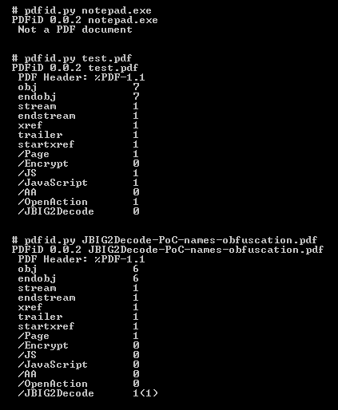
PDFid
Simple tool that scans a PDF for potentially-malicious objects.
Useful for quickly checking if a PDF contains an OpenAction, JavaScript, or encryption (even if the name is obfuscated).
No support for analyzing encoded data.
Only useful for proving maliciousness, not for proving a PDF is benign.
Written by Didier Stevens
Notes:
Screenshot from https://blog.didierstevens.com/2009/03/31/pdfid/

Slide 18
pdf-parser
Tool for extracting data from PDF files.
Also written by Didier Stevens
Designed for deeper analysis of PDFs triaged with pdfid:
“The idea is to use this tool [pdfid] first to triage PDF documents, and then analyze the suspicious ones with my pdf-parser”
Supports extracting PDF statistics (-a) and specific encoded objects (--filter --raw --object=<num>) from a PDF file.

Slide 19
peepdf
Swiss army knife for PDF Analysis
Default operation is to dump the PDF’s contents
Supports:
Extracting individual objects
Scoring PDFs for maliciousness
Analyzing and reformatting embedded JavaScript
Interactive interface
XML Output
Overall, a more useful tool than pdf-parser

Slide 20
peepdf –Output
Usage: peepdf.py [options] PDF_file
Version: peepdf 0.3 r275
Options:
-h, --help show this help message and exit
-i, --interactive Sets console mode.
-s SCRIPTFILE, --load-script=SCRIPTFILE
Loads the commands stored in the specified file and
execute them.
-c, --check-vt Checks the hash of the PDF file on VirusTotal.
-f, --force-mode Sets force parsing mode to ignore errors.
-l, --loose-mode Sets loose parsing mode to catch malformed objects.
-m, --manual-analysis
Avoids automatic Javascript analysis. Useful with
eternal loops like heap spraying.
-u, --update Updates peepdf with the latest files from the
repository.
-g, --grinch-mode Avoids colorized output in the interactive console.
-v, --version Shows program's version number.
-x, --xml Shows the document information in XML format.
-j, --json Shows the document information in JSON format.
-C COMMANDS, --command=COMMANDS
Specifies a command from the interactive console to be
executed.
$ ./peepdf.py sample.pdf
File: sample.pdf
MD5: f77cca021c686f1ebe5c98cbfaa8c53a
Size: 1312 bytes
Version: 1.1
Binary: False
Linearized: False
Encrypted: False
Updates: 0
Objects: 8
Streams: 2
Comments: 0
Errors: 0
Version 0:
Catalog: 2
Info: 8
Objects (8): [1, 2, 3, 4, 5, 6, 7, 8]
Streams (2): [1, 5]
Encoded (0): []
Suspicious elements:
/OpenAction: [2]
/JS: [6]
/JavaScript: [6]
Notes:
Source: https://github.com/jesparza/peepdf/wiki/Execution

Slide 21
PDF Stream Dumper
Graphical tool specifically designed for analyzing malicious PDFs.
Many useful features:
Allows filtering displayed objects
Includes tools for analyzing malicious JavaScript and shellcode
Can open encrypted PDFs

Slide 22
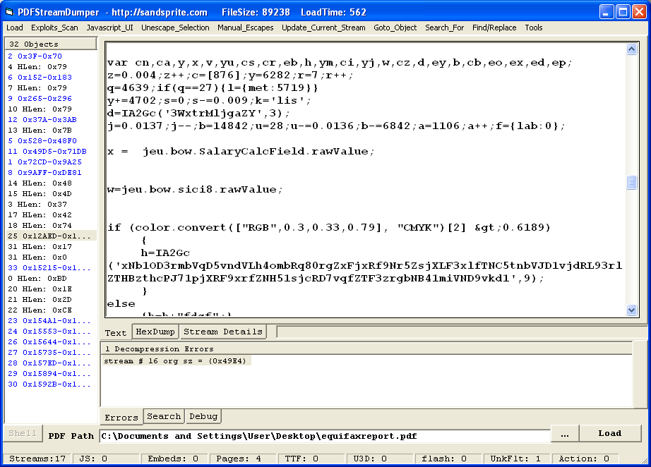
PDF Stream Dumper – Output
Notes:
Source: http://www.kahusecurity.com/2011/pdf-analysis-using-pdfstreamdumper/

Slide 23
PDF Analysis Pitfalls
Pitfalls:
PDFs can be encoded, so the strings command often isn’t useful.
Difficult to fully automate phishing analysis, because words aren’t always stored as textual data.
PDF analysis tools and libraries (PDFminer, PyPDF2) are nowhere near fully supporting all PDF features.
Encryption:
PDF files can be encrypted (with or without a password)
Many tools do not support analyzing encrypted PDFs
Encoding:
Objects in a PDF can be encoded with many types of encoders.
Encoders can be nested multiple times, making manual analysis impractical.
Many tools do not support all encoding types present in malicious PDFs

Slide 24
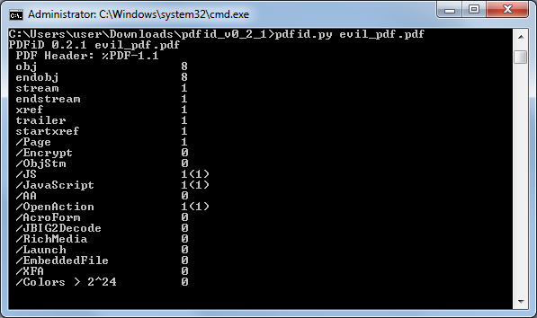
Demo: Analyzing a PDF (1/2)

Slide 25
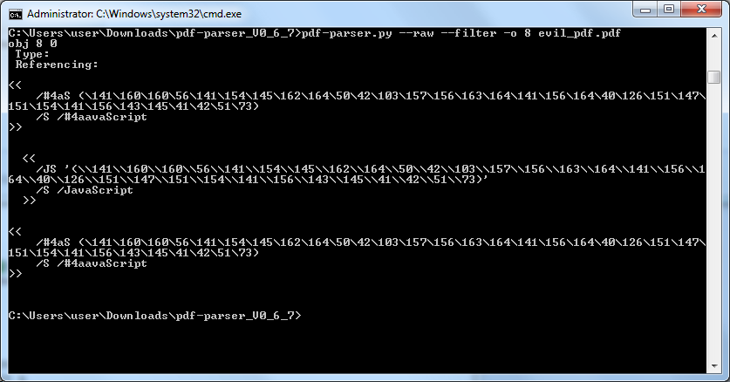
Demo: Analyzing a PDF (1/2)
Default action is to dump contents of the PDF
The JavaScript object is at object 8

Slide 26
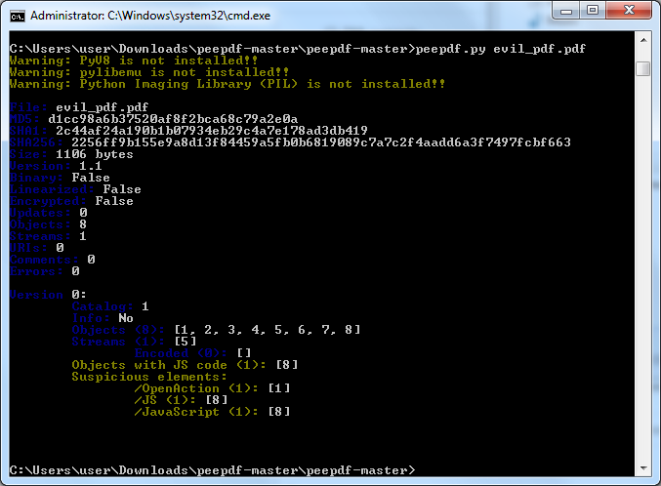
Demo: Analyzing a PDF (1/2)

Slide 27
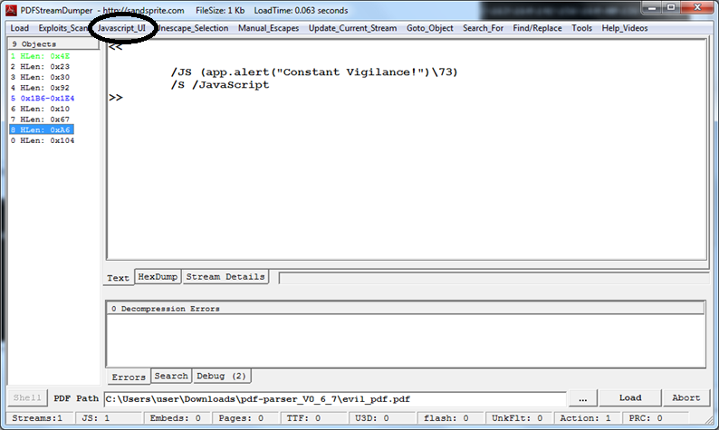
Demo: Analyzing a PDF (1/2)

Slide 28
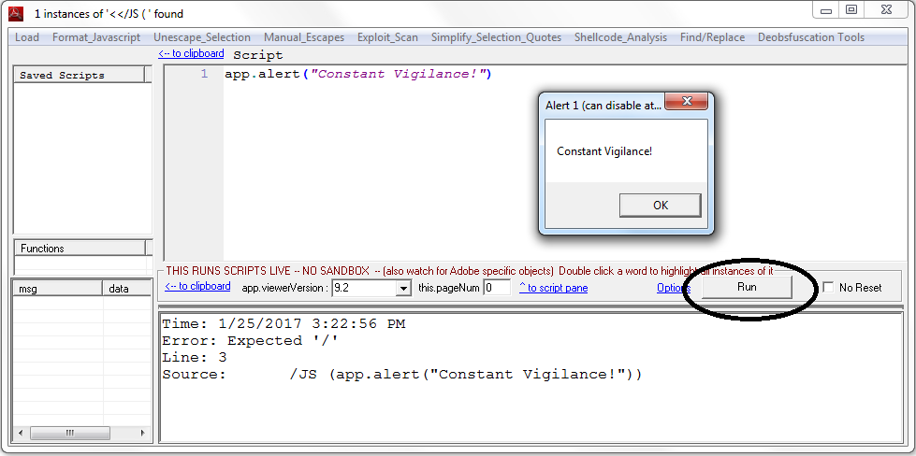
Demo: Analyzing a PDF (1/2)

Slide 29
References and Further Reading (1/2)
Technical References:
PDF Reference sixth edition - http://wwwimages.adobe.com/content/dam/Adobe/en/devnet/pdf/pdfs/pdf_reference_1-7.pdf
PDF file format - http://lotabout.me/orgwiki/pdf.html
A Brief History of the PDF File - http://www.investintech.com/resources/articles/pdffilehistory/
Physical and Logical Structure of PDF Files - https://blog.didierstevens.com/2008/04/09/quickpost-about-the-physical-and-logical-structure-of-pdf-files/
Advanced PDF Tricks - https://github.com/angea/PDF101/raw/master/presentations/troopers15/Albertini%2BPfeifle%20-%20Advanced%20PDF%20Tricks.pdf
Tool Tutorials:
PDF Stream Dumper - https://www.youtube.com/watch?v=JAsTW73U1qI
PDF Stream Dumper - http://www.kahusecurity.com/2011/pdf-analysis-using-pdfstreamdumper/
pdf-parser.py, pdfid.py - https://blog.didierstevens.com/programs/pdf-tools/
peepdf - https://www.blackhat.com/docs/eu-15/materials/eu-15-Esparza-peepdf.pdf
peepdf - http://eternal-todo.com/tools/peepdf-pdf-analysis-tool
PDF Password Cracking With John The Ripper - https://blog.didierstevens.com/2015/04/15/pdf-password-cracking-with-john-the-ripper/
Full PDF Analysis - https://countuponsecurity.com/2014/09/22/malicious-documents-pdf-analysis-in-5-steps/
Malicious PDF Analysis Concepts:
Threat Modelling Adobe PDF - https://www.dst.defence.gov.au/sites/default/files/publications/documents/DSTO-TR-2730.pdf
PDF: Security Analysis and Malware Threats - http://www.orkspace.net/secdocs/Conferences/BlackHat/Europe/2008/New%20Viral%20Threats%20of%20PDF%20Language.pdf
Getting Owned by Maliicou PDF - https://www.sans.org/reading-room/whitepapers/malicious/owned-malicious-pdf-analysis-33443

Slide 30
References and Further Reading (2/2)
Past Attacks:
Escape From PDF - https://blog.didierstevens.com/2010/03/29/escape-from-pdf/
SophosLab sees malware exploiting /Launch - https://nakedsecurity.sophos.com/2010/04/12/trojpdfexdf-sophoslabs-sees-malware-exploiting-launch/
JBIG2 Exploit - https://blog.avast.com/2011/04/22/another-nasty-trick-in-malicious-pdf/
TIFF Exploit - https://www.rapid7.com/db/vulnerabilities/acrobat-cve-2017-2966
Tool Download Links:
pdfid - https://github.com/DidierStevens/DidierStevensSuite/blob/master/pdfid.py
pdf-parser - https://github.com/DidierStevens/DidierStevensSuite/blob/master/pdf-parser.py
peepdf - https://github.com/jesparza/peepdf
PDF Stream Dumper - http://sandsprite.com/blogs/index.php?uid=7&pid=57
Sample files:
http://contagiodump.blogspot.com/2013/03/16800-clean-and-11960-malicious-files.html

